Slide 1



WELCOME
TO THE MATHEMATICS DEPARTMENT

Slide 2





What is the difference
between a computer science student and a computer and information student?

Slide 3

Software Engineer :
a professional who designs, develops, and maintains computer software and applications,

Slide 4

UI /UX Designer :
specialist responsible for enhancing the overall user experience of a product, website, or application

Slide 5

Web Developer:
Font-End
professional who specializes in creating the user interface and user experience of websites. They use technologies such as HTML, CSS, and JavaScript

Slide 6

Web Developer:
Back-End
a professional who specializes in the server-side of web development. They are responsible for building and maintaining the infrastructure and functionality of websites and web applications.

Slide 7

Game developer:
A game developer is a professional who designs and codes video games to make them enjoyable and interactive for players

Slide 8

Cyber security:
professional responsible for designing, implementing, and maintaining security measures to protect computer systems, networks, and data from cyber threats and attacks.

Slide 9
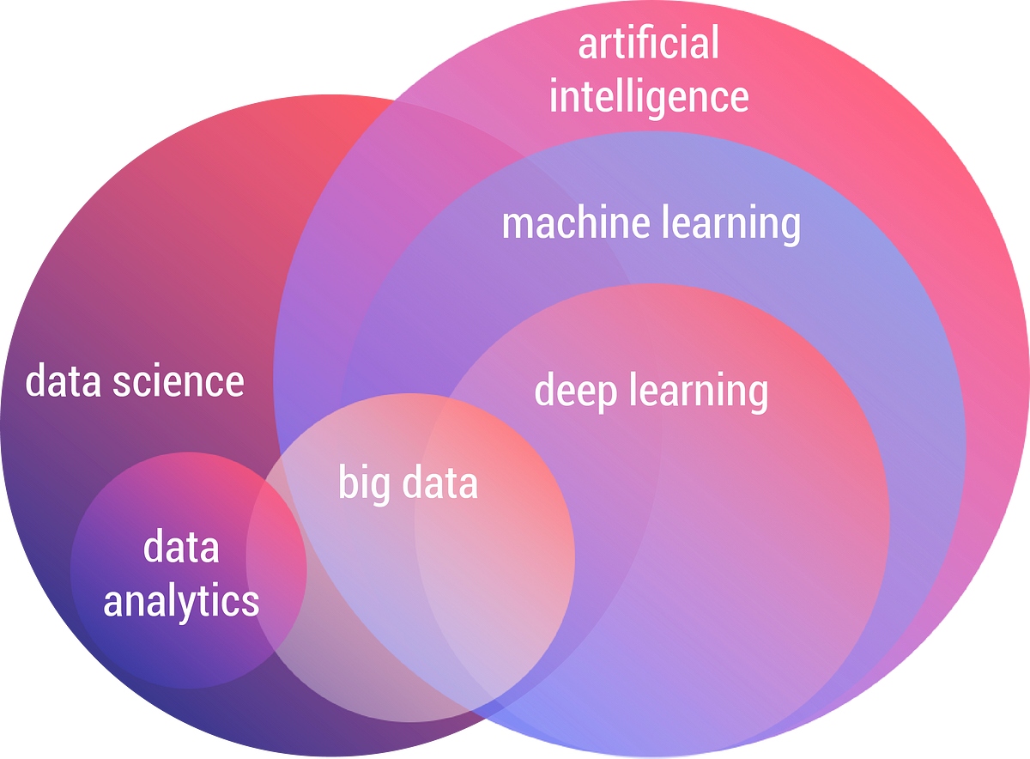
Data Science
Data analytics
Machine learning
Deep learning

Slide 10


The best free learning resources
Coursera
Edx
Mahara tech
iti
Creative

Slide 11


THANK YOU

Slide 12
MEMORY
TECHNOLOGY
Dr Alshaimaa Mostafa

Slide 13

What is the meaning of
SRAM and DRAM
Dr Alshaimaa Mostafa

Slide 14

Definition
SRAM (Static Random-Access Memory)
SRAM is a type of memory that uses a static storage cell made up of transistors. It does not require refreshing and is faster than DRAM, making it ideal for applications that require high-speed access to data.
DRAM (Dynamic Random-Access Memory)
DRAM is a type of memory that uses a dynamic storage cell made up of a capacitor and a transistor. It requires refreshing to prevent data loss and is slower than SRAM, but it has a higher storage capacity, making it ideal for applications that require large amounts of memory.
Dr Alshaimaa Mostafa

Slide 15
What is the difference
between
SRAM and DRAM
In Pros and Cons
Dr Alshaimaa Mostafa

Slide 16

TEAM NAMES
Yara Fatouh
Ali Arabi Ali
Salwa Ali
Rodan Mohamed
Dr Alshaimaa Mostafa

Slide 17

TEAM NAMES
Yara Fatouh
Ali Arabi Ali
Salwa Ali
Rodan Mohamed
Dr Alshaimaa Mostafa

Slide 18
THANK YOU

